Slide 1
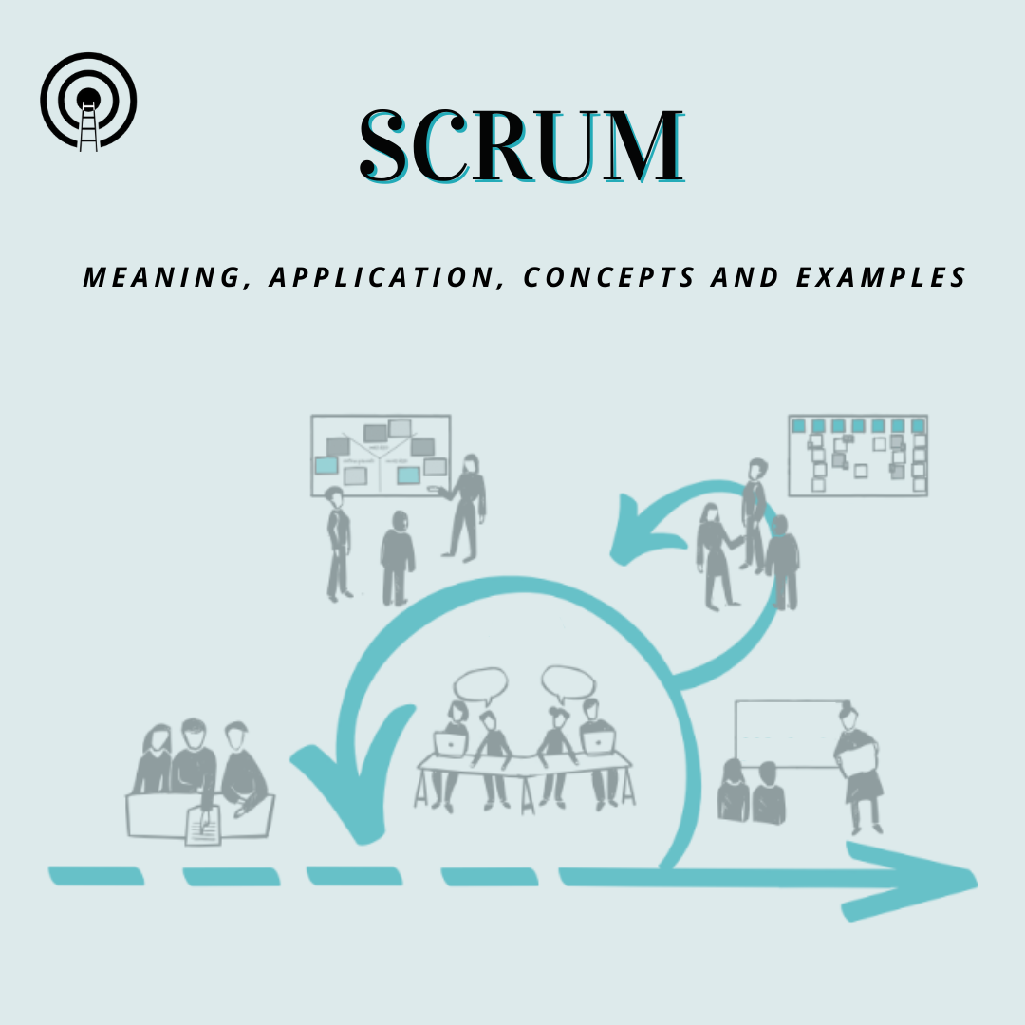
SCRUM-
Scrum is a framework for project management that emphasizes teamwork, accountability and iterative progress toward a well-defined goal. The framework begins with a simple premise: Start with what can be seen or known. After that, track the progress and tweak, as necessary.
Scrum is often part of Agile software development. It is named for a rugby formation in which everyone plays a role.

Slide 2
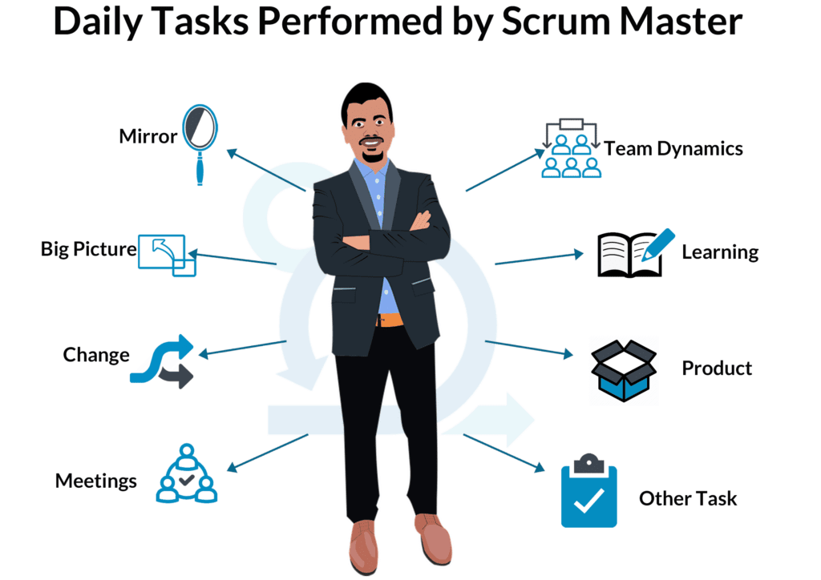
SCRUM MASTER-
The scrum master helps to facilitate scrum to the larger team by ensuring the scrum framework is followed. He/she is committed to the scrum values and practices, but should also remain flexible and open to opportunities for the team to improve their workflow.

Slide 3
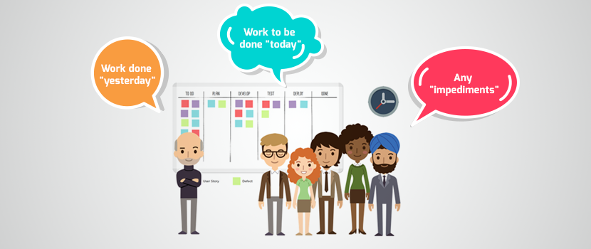

DAILY SCRUM-
Daily scrums are quick meetings held each day at the same time for members of the product development team working on a particular sprint.
Daily scrums help level-set the team and ensure everyone knows what they’re working on for the next day. If things are running behind, resources should get reallocated accordingly. If developers have already completed their assigned tasks, they’ll be given new items from the Sprint Backlog.

